Slide 1
Semantic Segmentation:
FCN + ResNet
From origin to Improvement
Presenter: 58119125蒋卓洋
58119128鲁洋洋
58119132李凯新

Slide 2
01
Task & Motivation
02
Models & Methods
03
Result & Conclution
Notes:
我们的展示分为三个部分：
任务与动机
模型与方法
结果与总结

Slide 3
Task &
Motivation
Notes:
首先是任务与动机

Slide 4
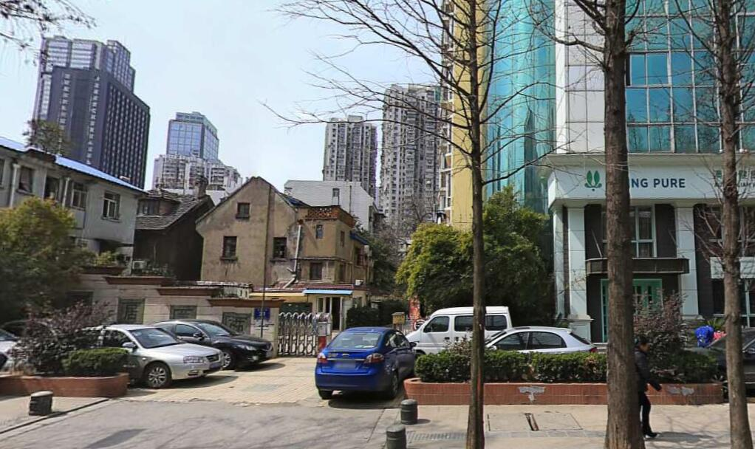
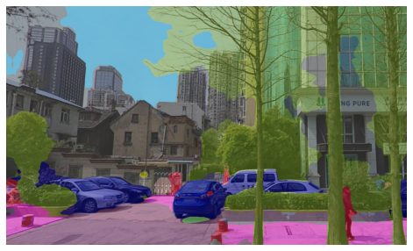
Task
Semantic Segmentation
Location
Work
Visual
Scene
Input
Classification
Work
Components
Category
Output
Classify
Each Pixel
Notes:
我们的任务是语义分割，他以视觉场景为输入，以场景要素的类别为输出。
这是一个分类问题，并且要求在图像中定位具体要素，
对计算机来说，定位要依靠像素的位置信息来完成，所以这是一个对像素的分类任务。

Slide 5
Task
Semantic Segmentation
Classifiction Task
Pixel Level Task
Image level classifiction task has good performance with Artificial Neural Network
Deep Learning
Model
??HOW??
Image Level
Pixel Level
Notes:
图像分类任务中，人工神经网络模型效果很好，
所以我们想到，能否将他迁移到像素级别分类任务上，
关键就在于如何迁移。

Slide 6
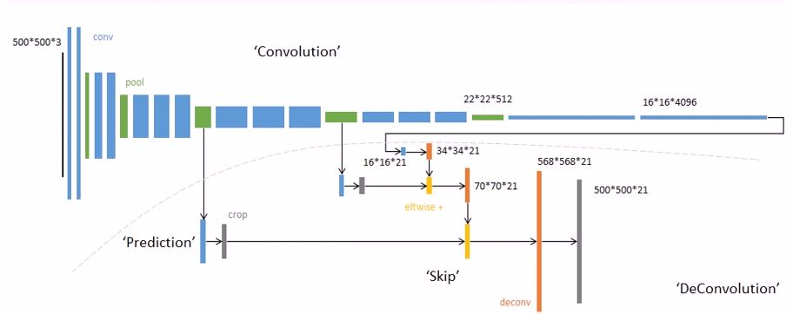
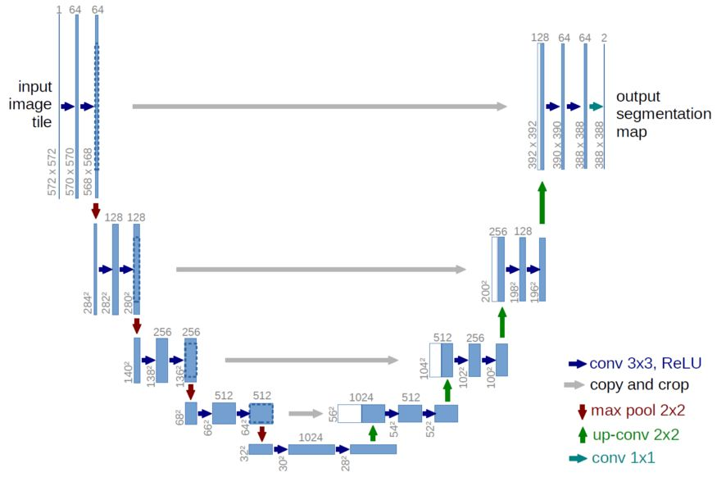
Task
FCN
Original NN frame for Segmentation Task
The core idea is the fusion of feature maps
U-net
Fully Convolutional
One of the core ideas is the splicing of feature maps
Encoder + Decoder
Notes:
我们先调研了现有的部分经典语义分割模型：
FCN首先完成了像素级的神经网络分类模型构建，提出了卷积编码加上采样译码的结构。
U-net类似，且有较具体的应用领域。

Slide 7
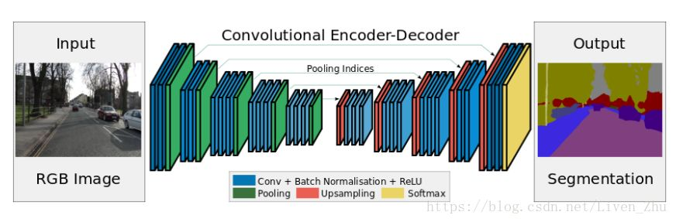
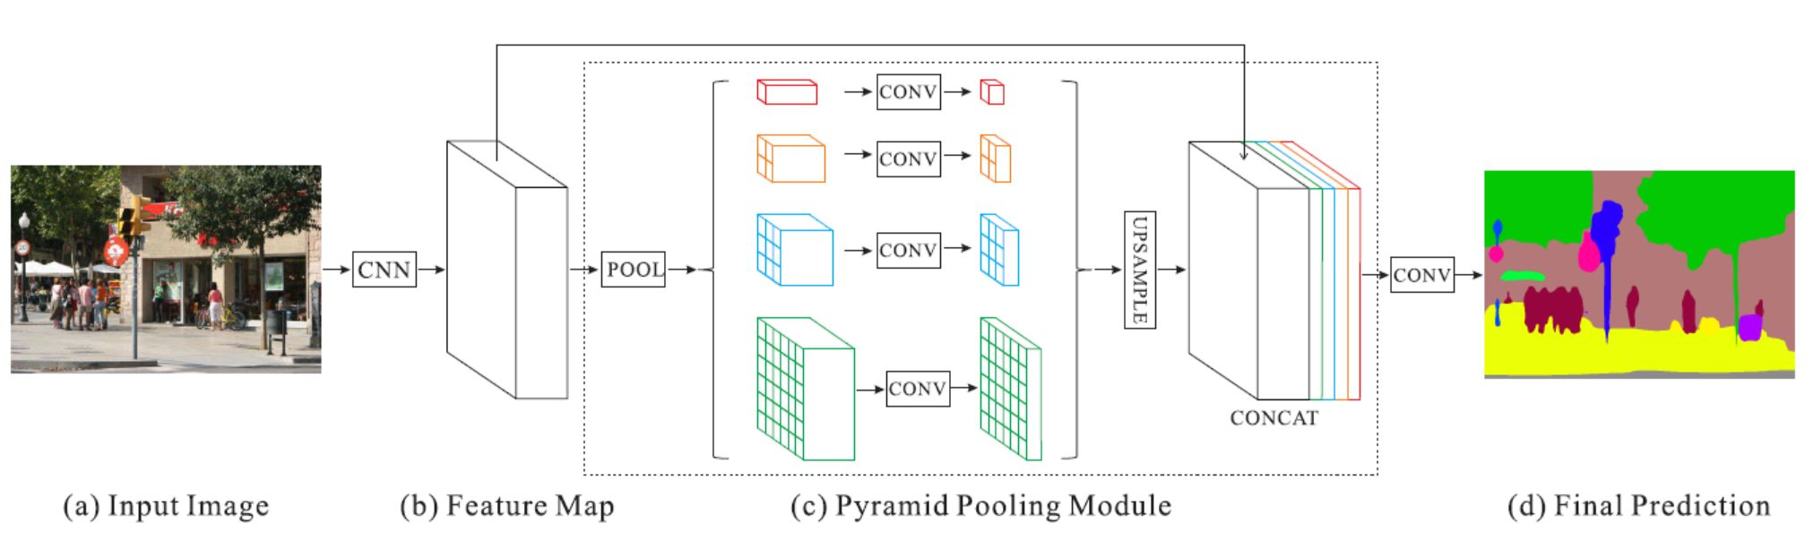
Task
SegNet
Propose anupsampling method based on maxPool index
Eliminate the need to learn upsampling and saving memory in the reasoning stage
PSPNet
The core idea is that the pyramid pooling module is proposed, and the model has empty convolution
Notes:
SegNet用反向最大池化改进了上采样，免去了上采样学习需求，节省开销
PSPNet提出了金字塔池化，结合了多尺寸信息

Slide 8
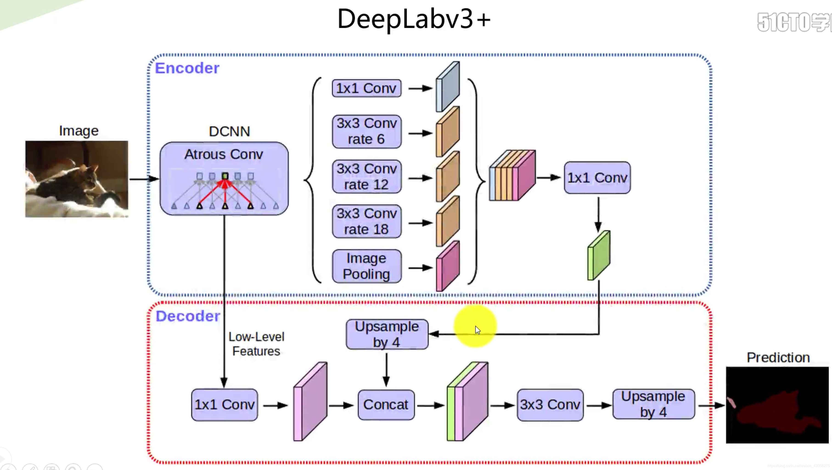
Task
DeepLab v1
Enlarge the receptive field with empty convolution.(Atrous)
CRF
DeepLab v2
Atrous spatial pyramid pooling (ASPP)
The flow is DCNN + Atrous convlution + CRF
DeepLab v3
DeepLab v3+
ASPP has more image-level feature
Mutil-grid is proposed instead of CRF
Backbone uses alignedxception (which has deep resolvable convolution)
Notes:
另一方面，一系列deeplab最重要的贡献是提出了：
用空洞卷积扩大感受野
以及用条件随机场对分割结果进行后处理

Slide 9
Motivation
Abundance Make Confuses?
Deconstruction Development Distory
Important
point 1
Original
Thought
FCN
QA Systerm
+ ResNet
Important
point 2
Improvement
Ideas
Notes:
这么多模型让我们觉得过于繁杂，
于是我们抓住两个我们认为的重点：
一是溯源最初的想法，我们选择探究FCN
二是探究改进思路如何被提出，我们选择探究ResNet思想如何被引入。

Slide 10
Motivation
FCN
Traditional CNN Image classification frame’s
Disadvantages
Limited to Image Level
Unchangeable for Input Image
Task Driven
A Structure on Pixel Level with input size changeable.
+ ResNet
Two types of improvements
Spesific Task Driven
Frame Evolution
Frame Evolution
Structural evolution of DL
Structure adaptation for Encoder
Notes:
FCN的探究主要是任务驱动的：
因为图像级别分类任务的有两个缺陷，一是局限于图像级别二是输入尺寸不易变
改进思路有两种，一是下降到具体领域的改进，二是基于网络结构的改进。
ResNet的引入就是第二种，他既是一种优异的深度学习思想，又适应于FCN的编码结构。

Slide 11
Models &
Methods

Slide 12
Models & Method
Model
Understand the functional defects of CNN to better explain what problems the FCN solves.
CNN
Methods
Creativity and Progress of FCN
FCN
Explore an improvement idea
+ResNet
Notes:
我们需要先搞清楚传统CNN图像分类的缺陷在哪，
再了解FCN的开创性方法如何解决了CNN缺陷，
最后再引入改进思路。

Slide 13
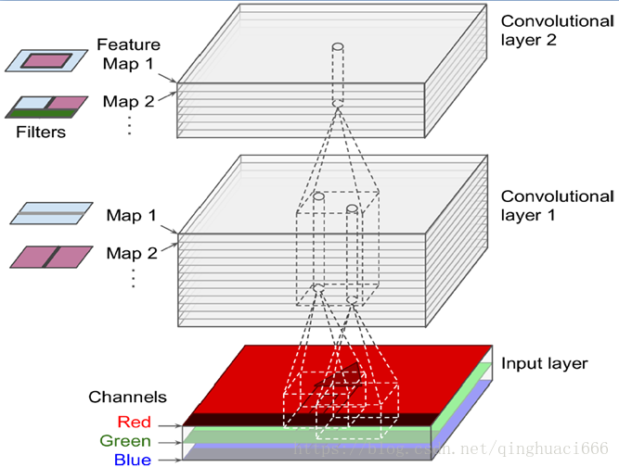
Models-CNN
CNN( like VGG )’s Defects
Image
Height * Width
* Channel(R/G/B)
Multichannel
Convolution
Convolution Layers
Final
3D Feature Map
Full Connection Layer
N-ary
Feature Vector
N Feature Values
N Classes’ Probability
Notes:
要理解CNN及之后的模型，必须理解多通道卷积的基础概念，
其中有两个重点，卷积核通道数与输入层一致，
卷积核的个数就反映了输出层数

Slide 14
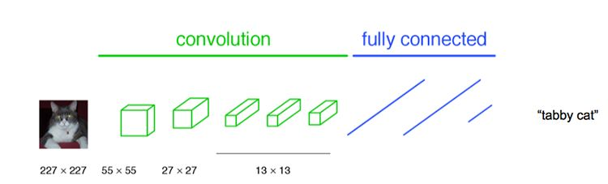
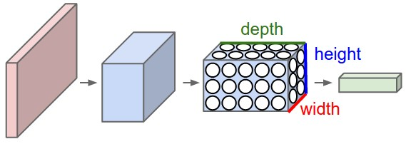
Models-CNN
CNN( like VGG )’s Defects
Image
Height * Width
* Channel
Convolution Layers
N 3D FC-kernels
(Each has the same size with Feature Map)
Final
3D Feature Map
Full Connection Layer
N-ary
Feature Vector
N Feature Values
N Classes’ Probability
Notes:
CNN将卷积得到的最终三维特征图，再输入全连接层，
这一层有N个三维全连接卷积核，之所以叫全连接，是因为他们的长深高与输入的三维特征图完全一致

Slide 15
Models-CNN
CNN( like VGG )’s Defects
Image:
H * W *
C(R/G/B)
Only Channel Dimension Left
1.
Limited to
Image Level
Height & Width Collapsed
Convolution Layers
N 3D FC-kernels
(Each has the same size with Feature Map)
Need to be Trained
2.
Unchangeable for Input Image Size
Fixed Size with 3D Feature Map
Final
3D Feature Map
Full Connection Layer
N-ary
Feature Vector
N Feature Values
N Classes’ Probability
Notes:
全连接将高宽维度坍到一维，只剩下通道维度表示类别，所以CNN只能研究整张图像的信息。
另外，全连接卷积核与特征图的尺寸绑定在了一起，作为参数，他们是需要训练的，
如果改变输入尺寸就得重新训练。

Slide 16
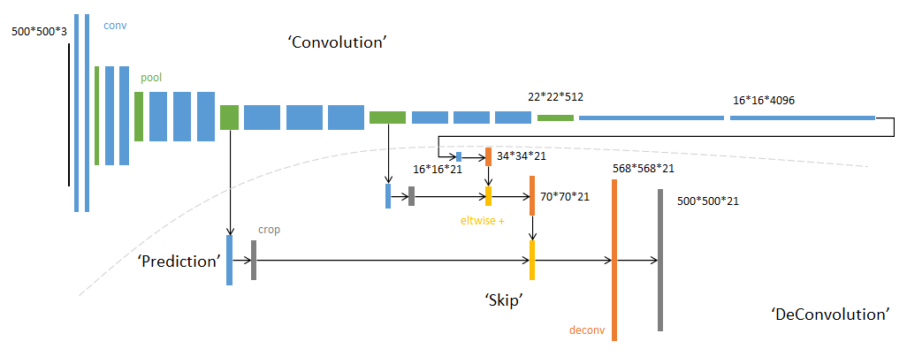
Models-FCN
To solve CNN’s Defects
Image:
H * W *
C(R/G/B)
FCN(Encoder + Decoder)
For each pixel:
N-ary
Feature Vector
Category Feature Map
Height * Width
(Same to Image)
*Channel
(Class #)
Convolution Layers
Conv+Pooling
3D Feature Map
Full Convolution Layer
Final
3D Feature Map
Upsampling layer
Deconvolution +
Fusion + Skip
Notes:
基于这两点，FCN提出了编码与译码结构

Slide 17
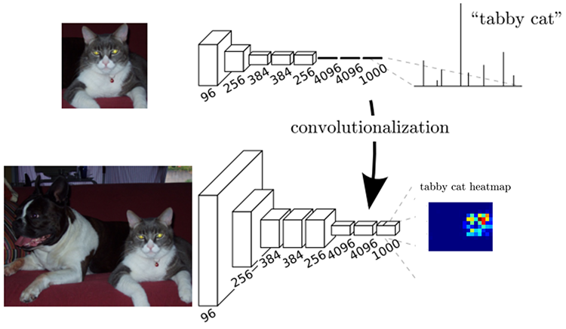
Models-FCN
To solve CNN’s Defects
Image:
H * W *
C(R/G/B)
FCN
For each pixel:
N-ary
Feature Vector
Category Feature Map
Height * Width
(Same to Image)
*Channel
(Class #)
Convolution Layers
3D Feature Map
# Hf * Wf
3D 1*1* Cf kernels
Final
3D Feature Map
Upsampling layer
Deconvolution +
Fusion + Skip
Full Convolution Layer
Notes:
首先将全连接层替换为全卷积层，对3D特征图进行全卷积，
从而维持了宽高尺寸尺寸，深化了特征

Slide 18
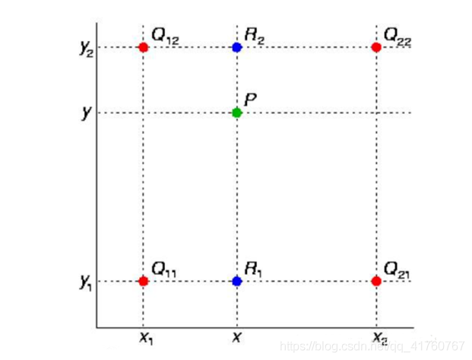
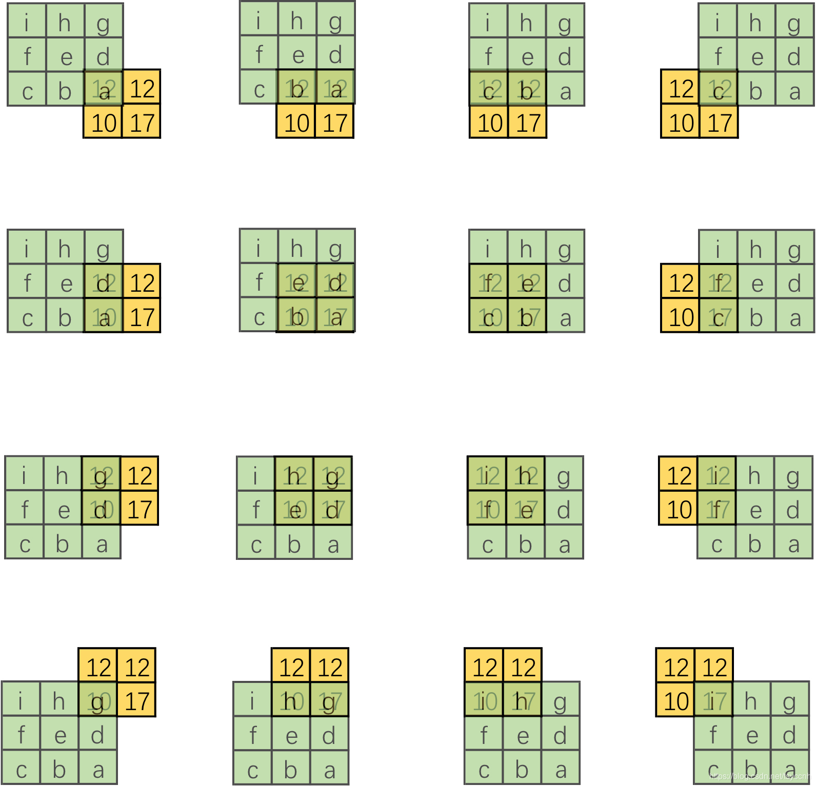
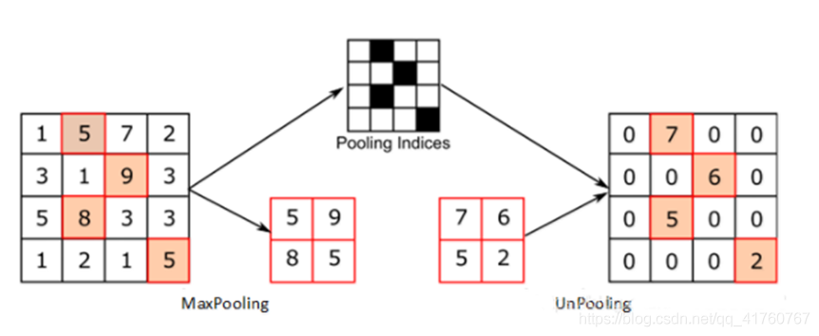
Models-FCN
FCN
Image:
H * W *
C(R/G/B)
√
For each pixel:
N-ary
Feature Vector
Category Feature Map
Height * Width
(Same to Image)
*Channel
(Class #)
Convolution Layers
3D Feature Map
Full Convolution Layer
Final
3D Feature Map
Upsampling layer
Deconvolution +
Fusion + Skip
Notes:
然后进行上采样，上采样有多重方法，这里我们介绍转置卷积

Slide 19
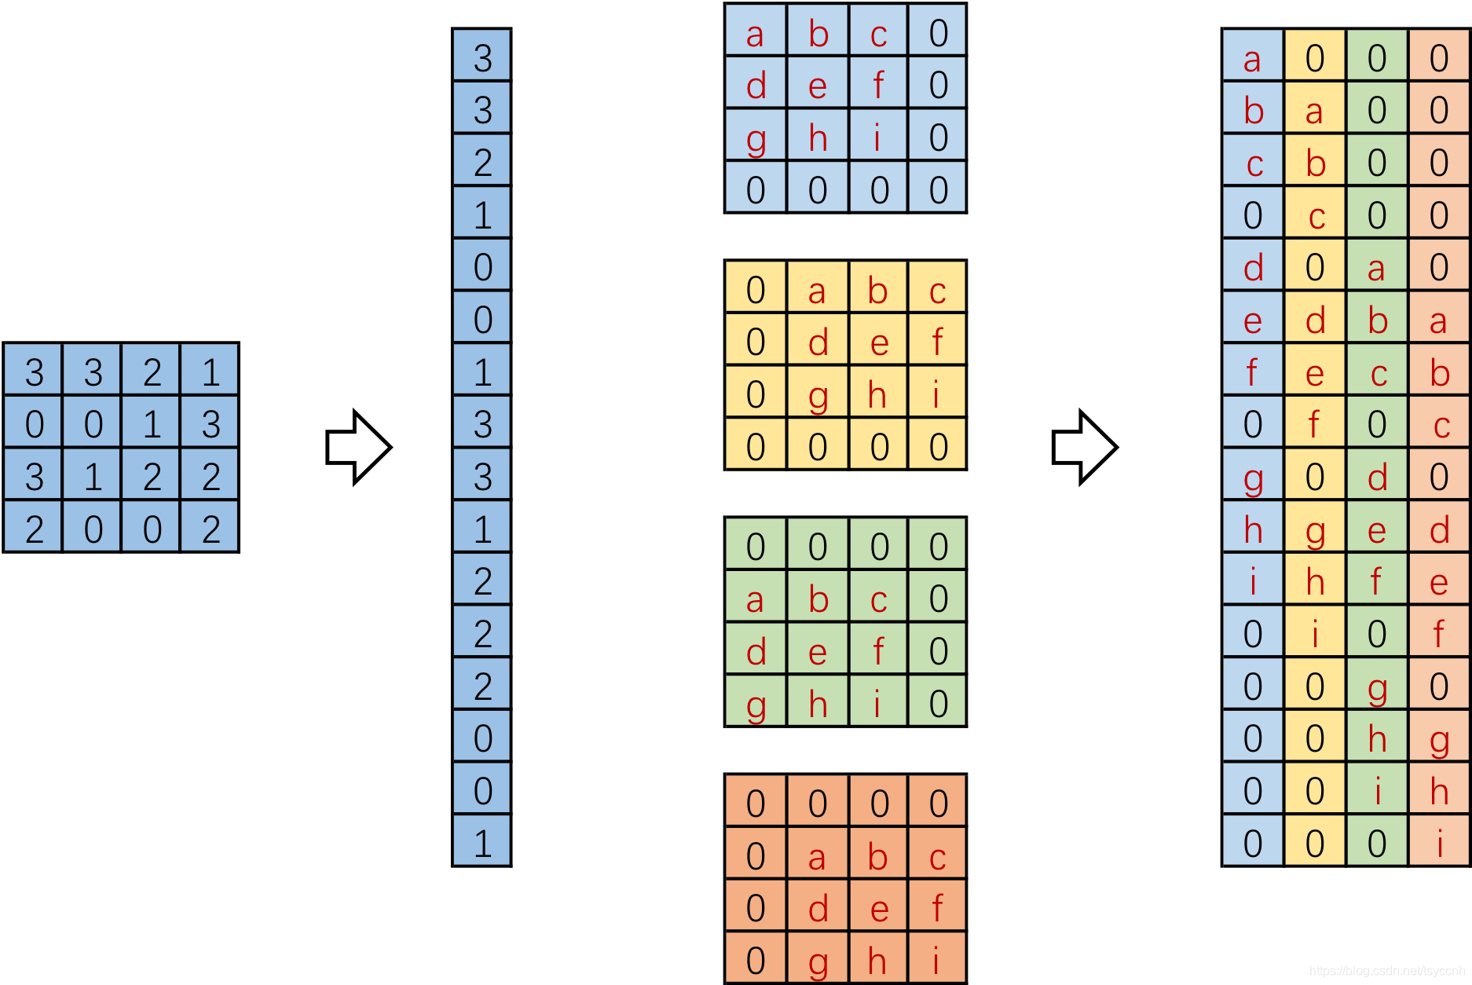
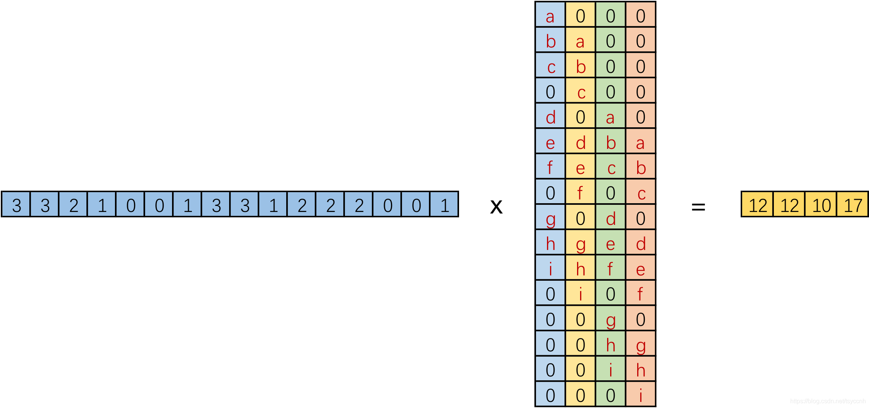
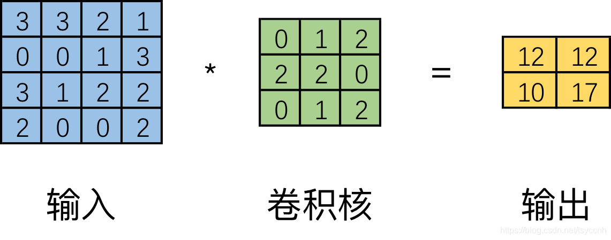
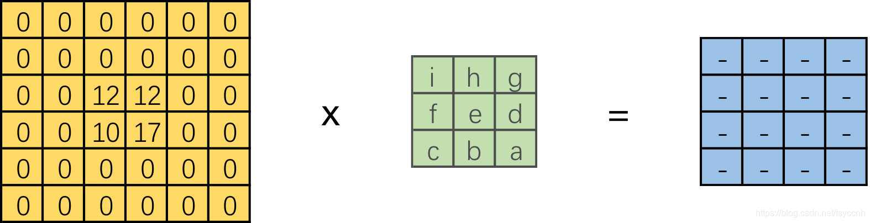
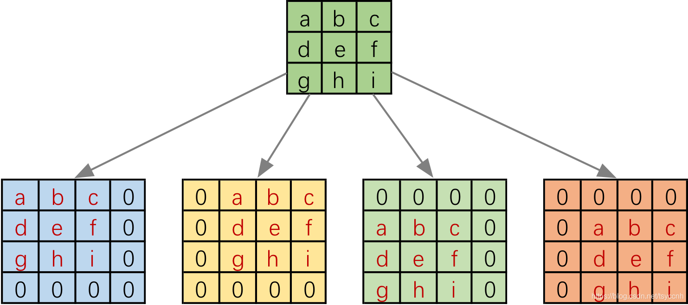
Models-FCN
Deconvolution
√
Deconvolution
Notes:
转置卷积不是卷积的逆运算，
而是转置了卷积核运算矩阵，
目的是单纯的尺寸复原

Slide 20
Models-FCN
FCN
For each pixel:
N-ary
Feature Vector
Category Feature Map
Height * Width
(Same to Image)
*Channel
(Class #)
C
N
Deconvolution
Multiscale feature fusion
Skip
3D Feature Map
Full Convolution Layer
Final
3D Feature Map
Upsampling layer
Deconvolution +
Fusion Skip
Notes:
FCN还引入了多尺度特征融合和跳步的方法，
将上下采样个尺度3D特征图剪切适配，加法融合，
使得较浅的特征结果更为精细，较深的特征结果更为鲁棒。

Slide 21
Models-FCN
FCN
Image:
H * W *
C(R/G/B)
1.
Pixel Level Classifiction Task
For each pixel:
N-ary
Feature Vector
Category Feature Map
Height * Width
(Same to Image)
*Channel
(Class #)
Convolution Layers
2.
Changeable for Input Image Size
Size Reduction
Fixed Kernel (Parameter) size
3D Feature Map
Full Convolution Layer
Final
3D Feature Map
(Hf * Wf * Cf)
Upsampling layer
Deconvolution +
Fusion Skip
Notes:
最后剪切得到的类别特征图与原图宽高一致，以类别数量为通道数，
等价于对每个像素都构建了一个N类别特征向量。
这就解决了像素级类问题。
FCN不需全连接，
参数都独立于输入尺寸，这解决了输入尺寸不可变问题。

Slide 22
Models-FCN
VGG’s Default
The results are still not fine enough
Depth Optimization of Eecoder?
Notes:
FCN效果并不完美，编码结构就仍然可以优化

Slide 23
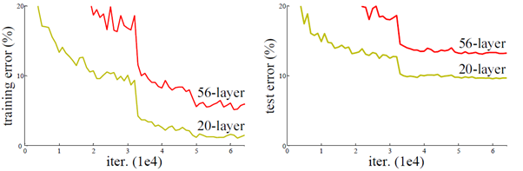
ResNet
Degradation problem

Slide 24
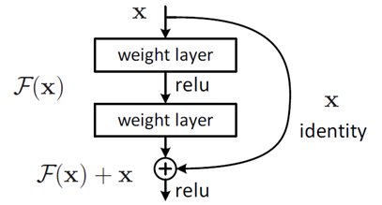
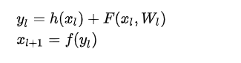
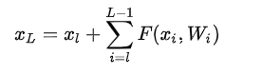
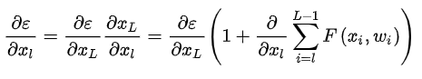
ResNet
Residual unit
The residual unit can be represented as :
Learning characteristics from shallow l to deep L :
Gradient of reverse process:

Slide 25
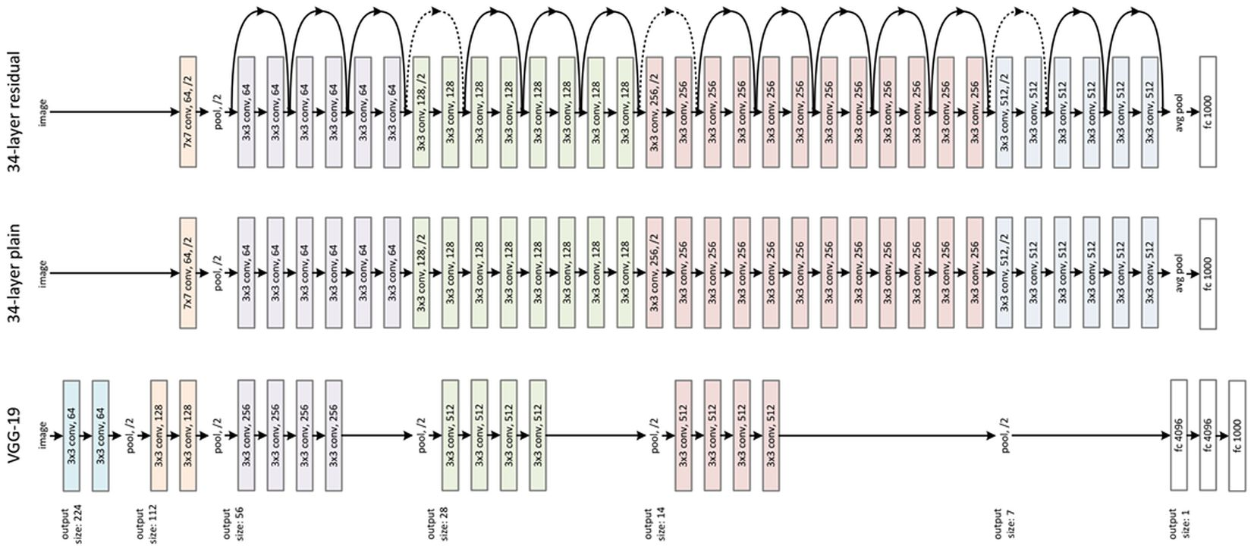
ResNet
ResNet

Slide 26
Models-Resnet_fcn
Image:
H * W *
C(R/G/B)
ResNet-FCN Training
For each pixel:
N-ary
Feature Vector
Initialize to Predefine ReNet
Category Feature Map
Height * Width
(Same to Image)
*Channel
(Class #)
Construct in steps to Train
ResNet
Encoder
Based on AKE_20K Dataset
Final
3D Feature Map
(Hf * Wf * Cf)
Upsampling layer
Deconvolution +
Fusion Skip
Notes:
训练ResNetFCN模型可以先用预训练模型对编码器初始化，
之后按步骤搭建后续网络进行训练，
我们在AKE_20K数据集上进行了训练

Slide 27
Result & Conclution
Notes:
接下来展示结果

Slide 28
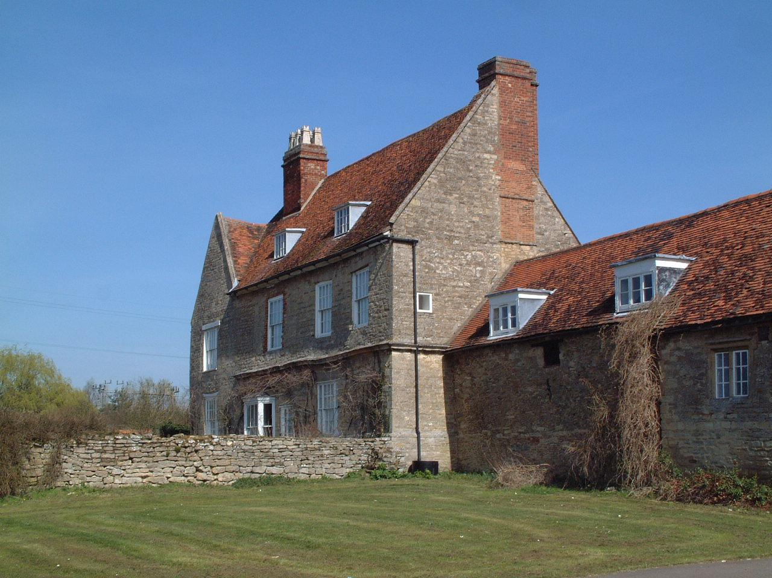
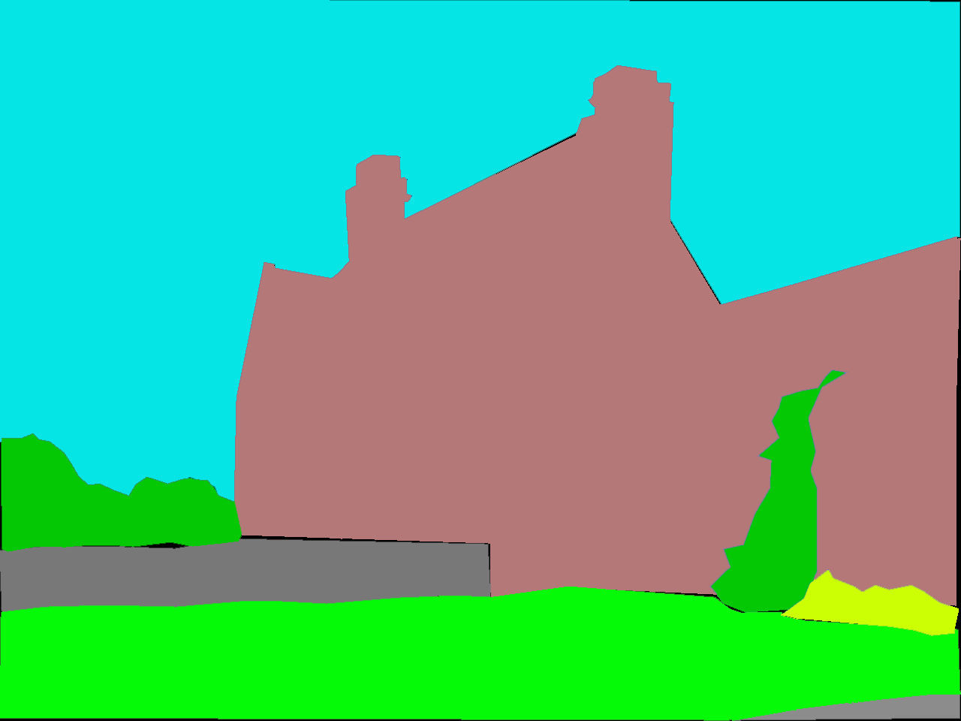
Result
For a specific case
Input Image
Label
Notes:
ADE数据集有户外场景的分割训练对象
这是一张测试集图像和他的标签

Slide 29
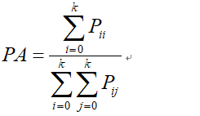
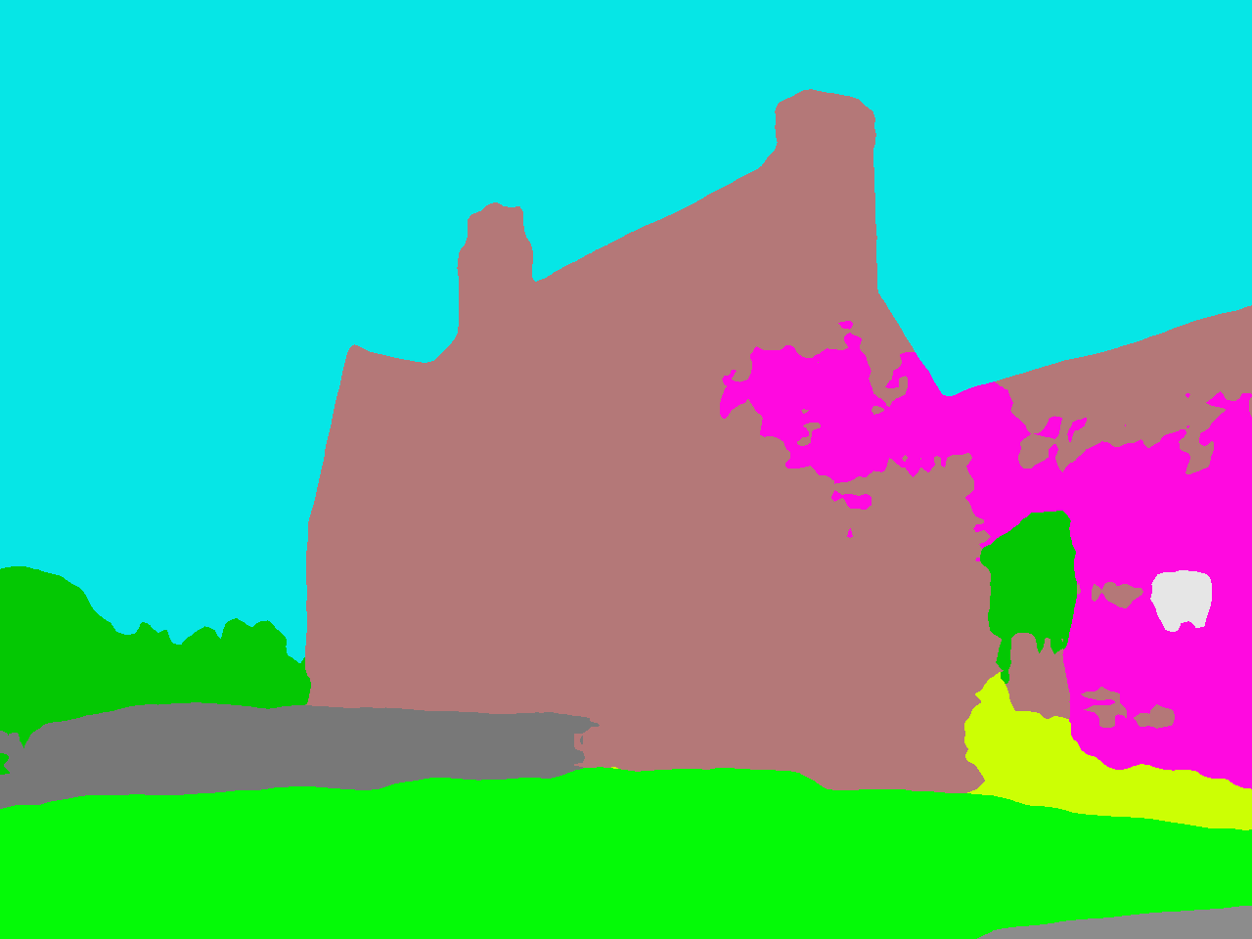
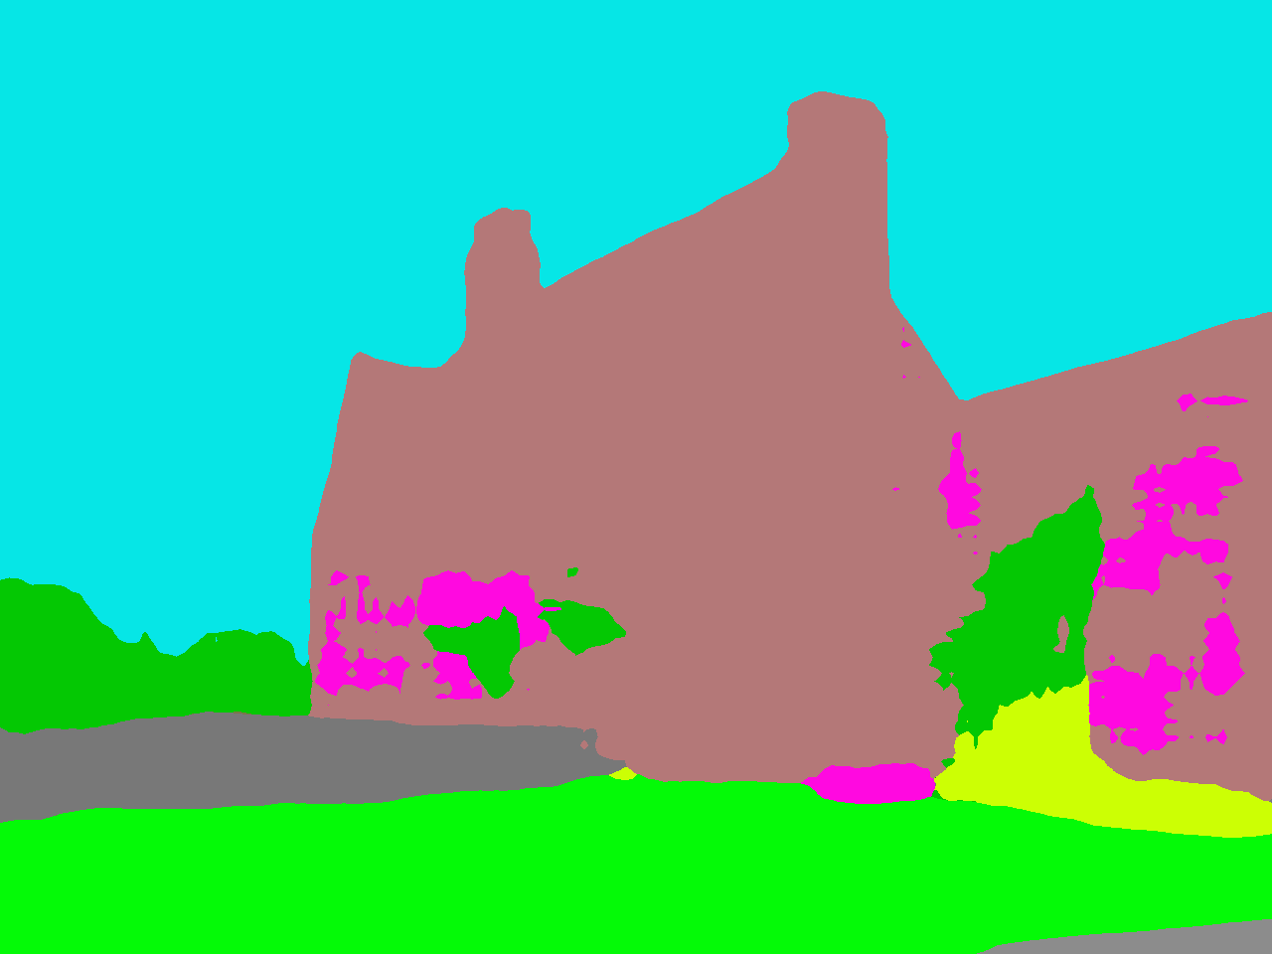
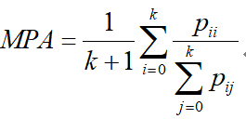
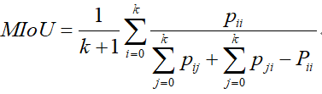
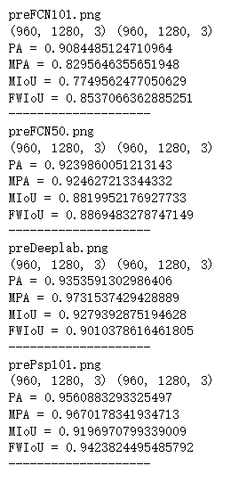
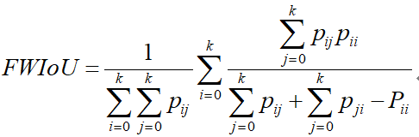
Result
Pixel Accuracy
Mean PA
resnet50_FCN
resnet101_FCN
Mean Intersection over Union
Good results are achieved
Frequency Weighted IoU
Notes:
右边是用两个训练好的ResnetFCN模型分割的结果。
PA是常规的像素分类正确率，MPA具体到类，MIoU对语义分割来说是最为标准的评价方法，FWIoU引入了类别权重
可以看到评价的数值结果还是可以的。

Slide 30
Result
1.
Pixel Level Classifiction Task
2.
Changeable for Input Image Size
resnet50_FCN
resnet101_FCN
3.
Better Performance with
Resnet Encoder
Good results are achieved
Notes:
结果部分得益于我们的模型的三个优点，
解决了像素级别任务，
使得输入尺寸可变，
用Resnet改进了编码器性能。

Slide 31
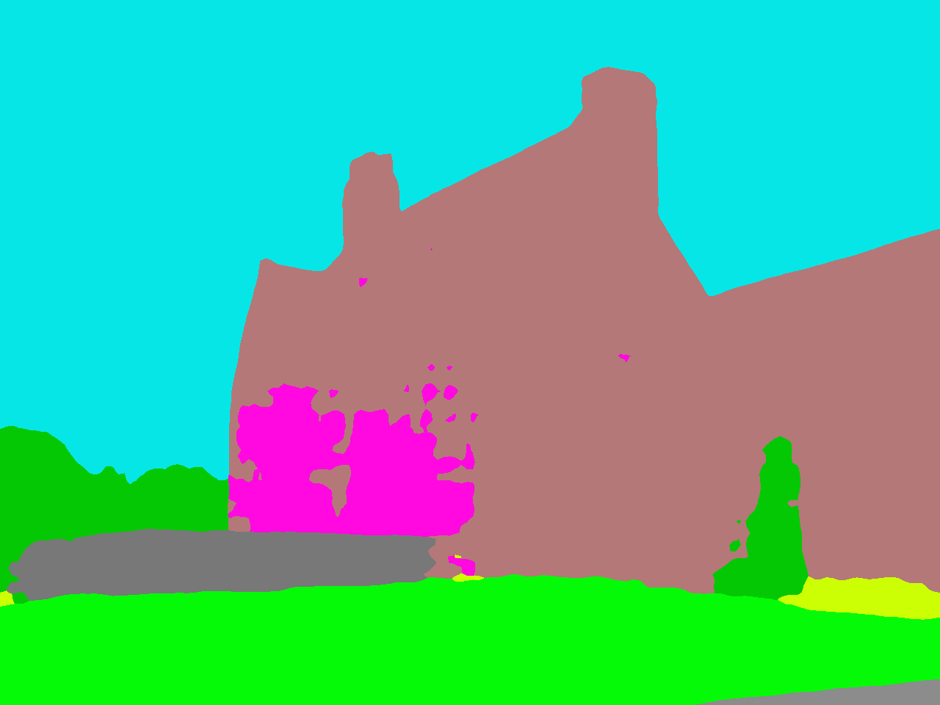
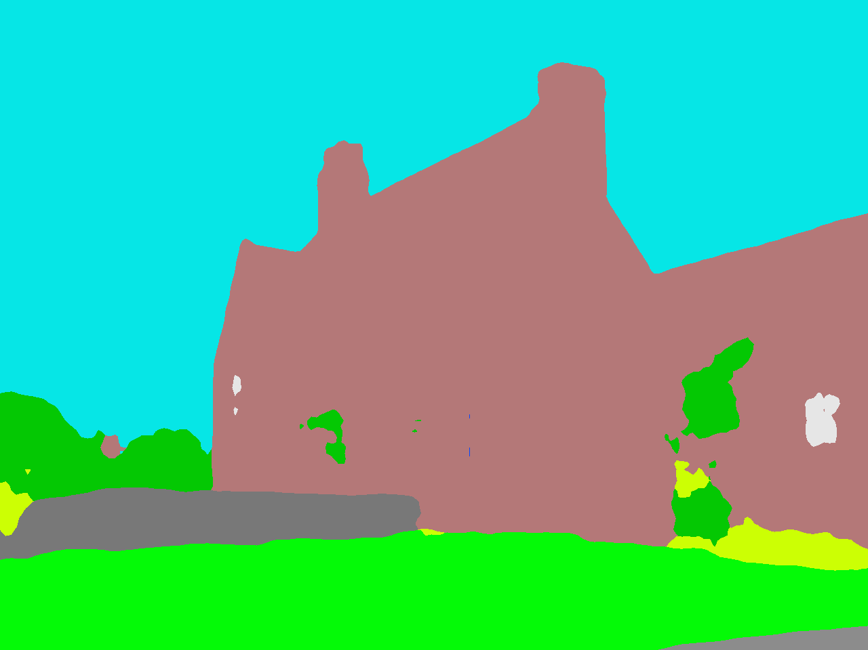
Result
resnet50_FCN
resnet101_FCN
Deeplab
resnet101_PSP
Notes:
但相对与其他之后提出的模型，还有一定差距

Slide 32
Conclution
Still not Enough
1.
1) The result of upsampling is still fuzzy and smooth
2) Not sensitive to the details in the image
2.
1) No considerition on the relation between pixels
2) No spatial regularization
3) Lacks spatial consistency
Notes:
主要有两方面原因，
一是上采样结果还是比较模糊和平滑，对图像中的细节不敏感
二是没有充分考虑像素与像素之间的关系

Slide 33
Conclution
Future Work
Improve the model structure according to the details of the link
Downsampling
Dilated Convolution to the Rescue
Atrous
Receptive field
Upsampling
Dense Upsampling Convolution
One time recovery
Learnable
Notes:
基于此，后续的工作主要有以下方向：
一是优化网络细节，比如改进下采样的卷积，提高感受野，或者改进上采样使用的方法。

Slide 34
Conclution
Future Work
Post process the segmentation results
e.g. Conditional random field
Consider global context information
e.g. Pyramid Pooling Module
............
Notes:
二是进行结果后处理，如用条件随机场进行后处理。
三是进一步考虑全局上下文图像信息，如构建金字塔结构。

Slide 35
Thanks for your listening!
Presenter: 58119125蒋卓洋
58119128鲁洋洋
58119132李凯新

